Slide 1
WELCOME

Slide 2
AGENDA
First Steps
ADOA & ASRS Retiree Health Insurance
Life Insurance
Retiree Accumulated Sick Leave (RASL)
Official Retirement Status
Return to Work

Slide 3
FIRST STEPS
Submit written notification to your department four weeks in advance of your expected retirement date. Be sure to include the date of your last day of work.
Initiate a pension application with Arizona State Retirement System four weeks prior to your retirement date.
Online at MyASRS: secure.azasrs.gov/web/Login.do

Slide 4
HOW RETIREMENT BENEFITS ARE DETERMINED
Total Credited ASRS Service
The amount of time you have been making contributions to ASRS
View your personal retirement estimate on the ASRS Website
azasrs.gov
Years of Service | Multiplier
00.00 to 19.99 | 2.10%
20.00 to 24.99 | 2.15%
25.00 to 29.99 | 2.20%
30.0 or higher | 2.30%
Graded Multiplier
ASRS Membership on or after July 1, 2011
Highest 60 consecutive months in last 120 months of contributions
ASRS membership prior to July 1, 2011
Highest 36 consecutive months in last 120 months of contributions
Average Monthly Compensation

Slide 5
ARIZONA STATE RETIREMENT SYSTEM
4400 E. Broadway Blvd., Ste. 200
Tucson, AZ 85711
Phone: 520-239-3100
602-240-2000
Email: Send secure messages or documents via your MyASRS account

Slide 6
ADOA BENEFIT SERVICES DIVISION
Benefit Services
100 N. 15th Ave., Ste. 260
Phoenix, AZ 85007
Phone: 800-304-3687
Fax: 602-542-4744
Email: benefitsissues@azdoa.gov
ADOA Retiree Enrollment Form Mail or fax to ADOA as early as three weeks prior to retirement date and no later than 30 days following retirement date.

Slide 7
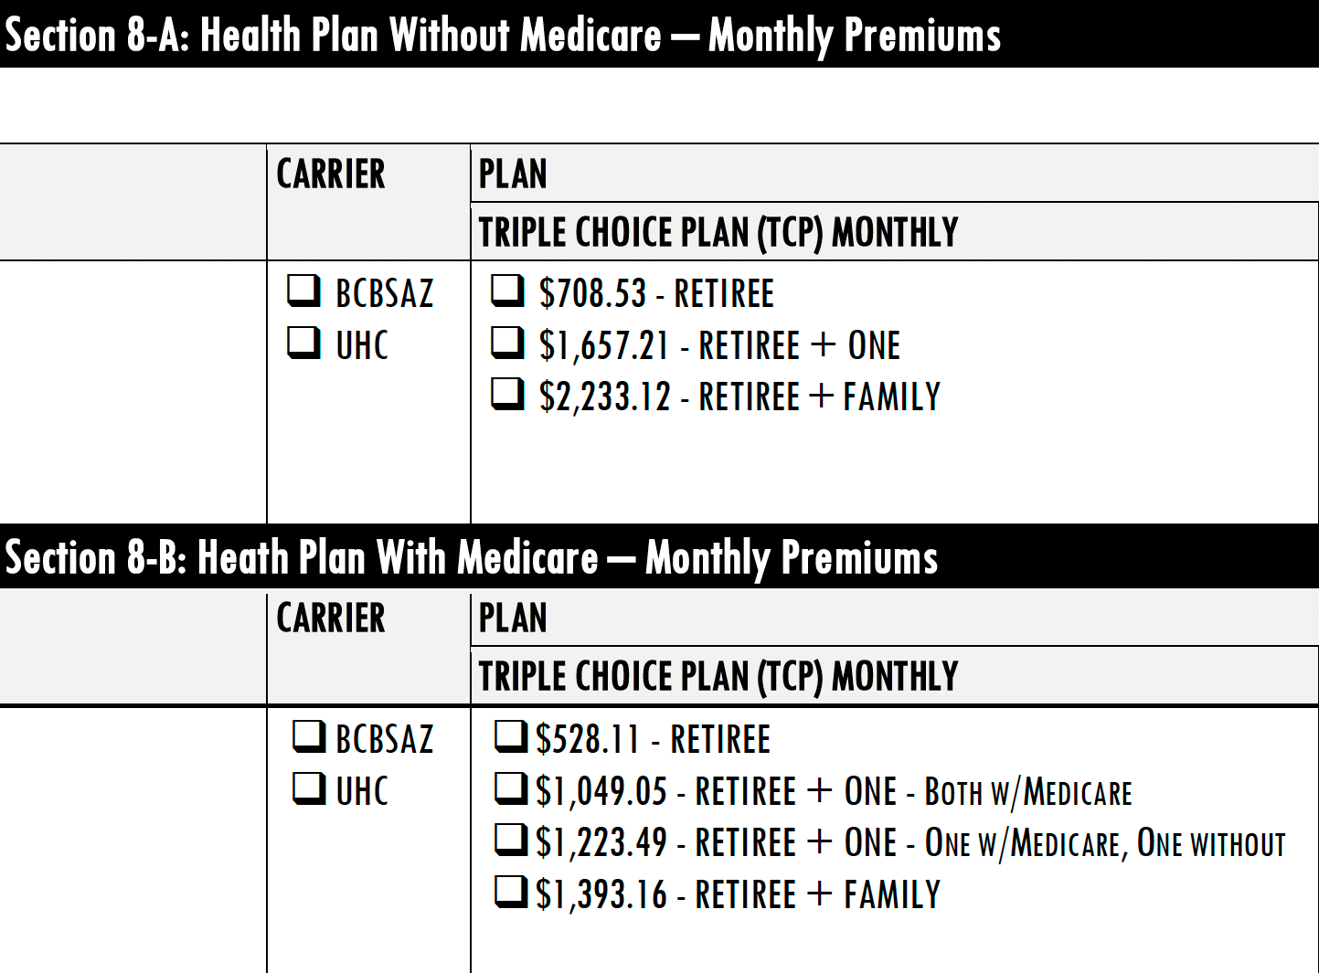
ADOA MEDICAL PREMIUMS

Slide 8
ADOA DENTAL PREMIUMS

Slide 9
ADOA VISION PREMIUMS
*ASRS health benefits are also available

Slide 10
ASRS INFORMATION
ARIZONA STATE RETIREMENT SYSTEM
The ASRS offers medical insurance (includes prescription and vision benefits), dental insurance, and a prescription discount card for retirees and their qualified dependents. Online health insurance enrollment is accessible from your secure myASRS account. The process is quick, safe and easy.
Web: azasrs.gov/content/health-care

Slide 11
ASRS MEDICAL PREMIUMS WITH MEDICARE
ASRS MEDICAL PLANS FOR MEDICARE-ELIGIBLE RETIREE & SPOUSE (Monthly Premium)

Slide 12
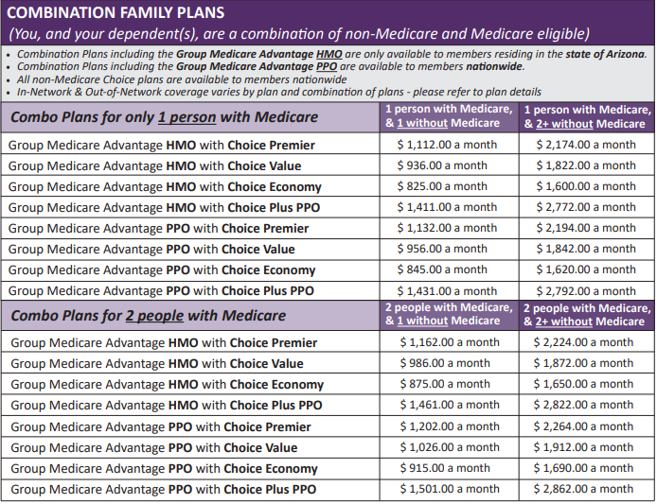
ASRS MEDICAL PREMIUMS WITH PARTIAL MEDICARE
ASRS MEDICAL PLANS FOR 1 OR 2 MEDICARE-ELIGIBLE INDIVIDUALS (Monthly Premium)

Slide 13
ASRS MEDICAL PREMIUMS WITHOUT MEDICARE
ASRS MEDICAL PLANS FOR NON-MEDICARE-ELIGIBLE INSURANCE (Monthly Premium)

Slide 14
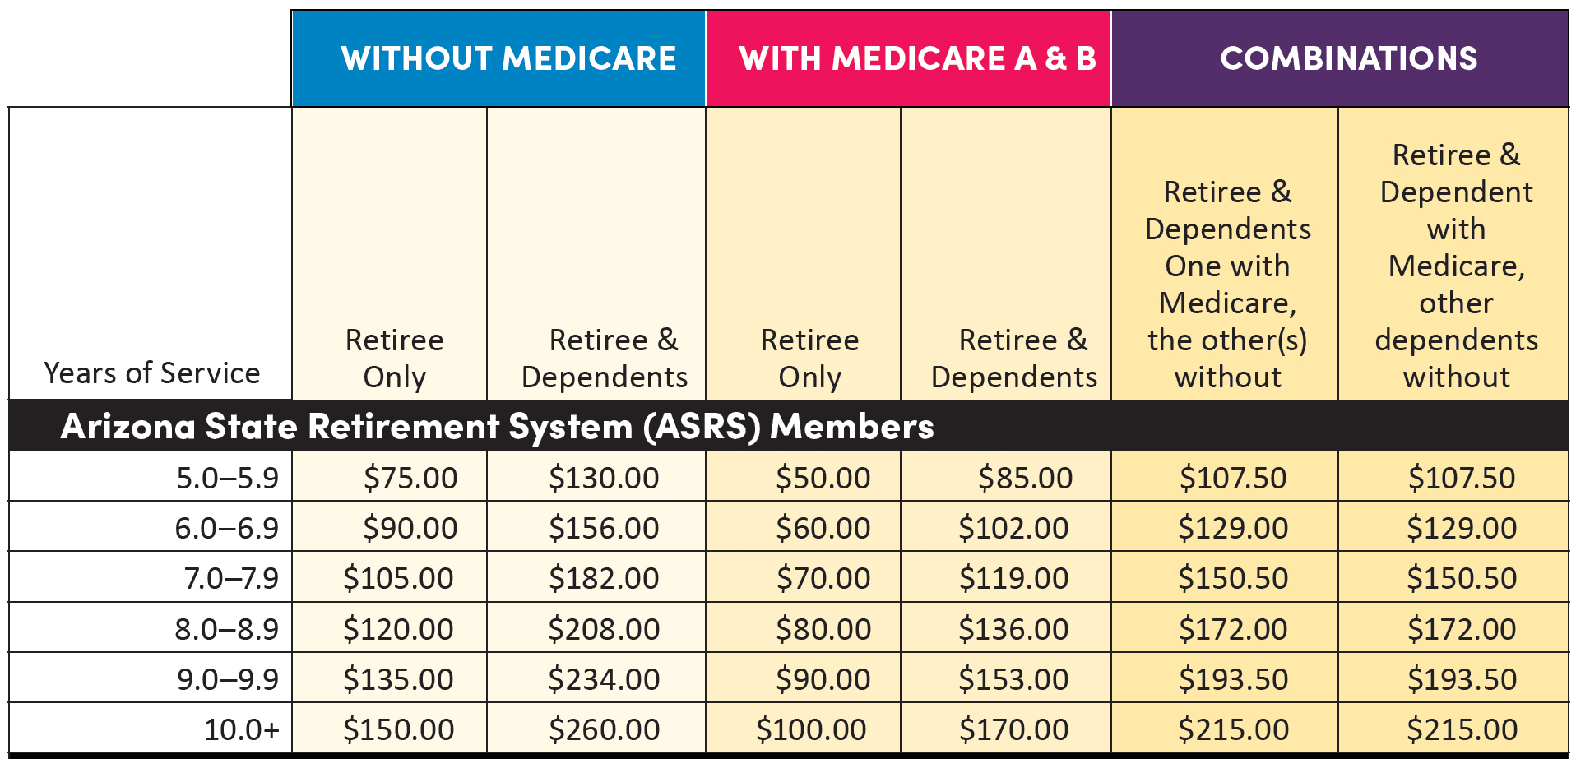
ASRS RETIREE INSURANCE SUBSIDY
ASRS

Slide 15
SOCIAL SECURITY
Research your options at ssa.gov or by contacting any Social Security Administration office.
MEDICARE
1-800-MEDICARE or medicare.gov
At least age 65
Part A (Hospital Insurance)
Covers most inpatient hospital expenses
Required to enroll
Part B (Supplementary Medical Insurance)
Covers a portion of doctor bills and other outpatient medical expenses
Not required to enroll so long as you are covered by your employer group health plan
Part D (Prescription Coverage)
Part C (Advantage) = Parts A, B, & D
SOCIAL SECURITY AND
MEDICARE INSURANCE

Slide 16
PIMA COUNCIL ON AGING 8467 E. Broadway Blvd.
Tucson, AZ 85710
Phone: 520-790-7262
Email: help@pcoa.org
Local Medicare Administrator: Provides Medicare workshops and advising Web: pcoa.org/ways-we-help/medicare
PCOA is a nonprofit organization dedicated to inclusive, innovative, and integrated services that meet the changing needs of Pima County’s older adults.

Slide 17
LIFE INSURANCE
SECURIAN
Convert or port life insurance
Must be completed within 30 days following separation from employment
Contact Securian for a quote and application
THE HARTFORD
Convert, port, or elect retiree coverage
Must be completed within 30 days following separation from employment
Contact The Hartford for a quote and application

Slide 18
RETIREE ACCUMULATED SICK LEAVE
ELIGIBILITY FOR RASL
To receive the RASL benefit, you must meet the eligibility criteria below. Final eligibility is determined by ADOA General Accounting Office:
Be an active Arizona State employee at the time of retirement.
Request your pension from ASRS within 31 calendar days of your separation date.
Have 500 or more hours of accrued unused sick leave at the time of retirement.
Apply in writing for the RASL benefit within 180 days of your retirement date: complete the RASL Certification Forms and return to UA Division of Human Resources.
Note: If you intend to take the deferred compensation option, you must open a Nationwide 457 deferred compensation account prior to ending your employment.
There are no extensions to these deadlines. If you miss them, you permanently and irrevocably forfeit the benefit.

Slide 19
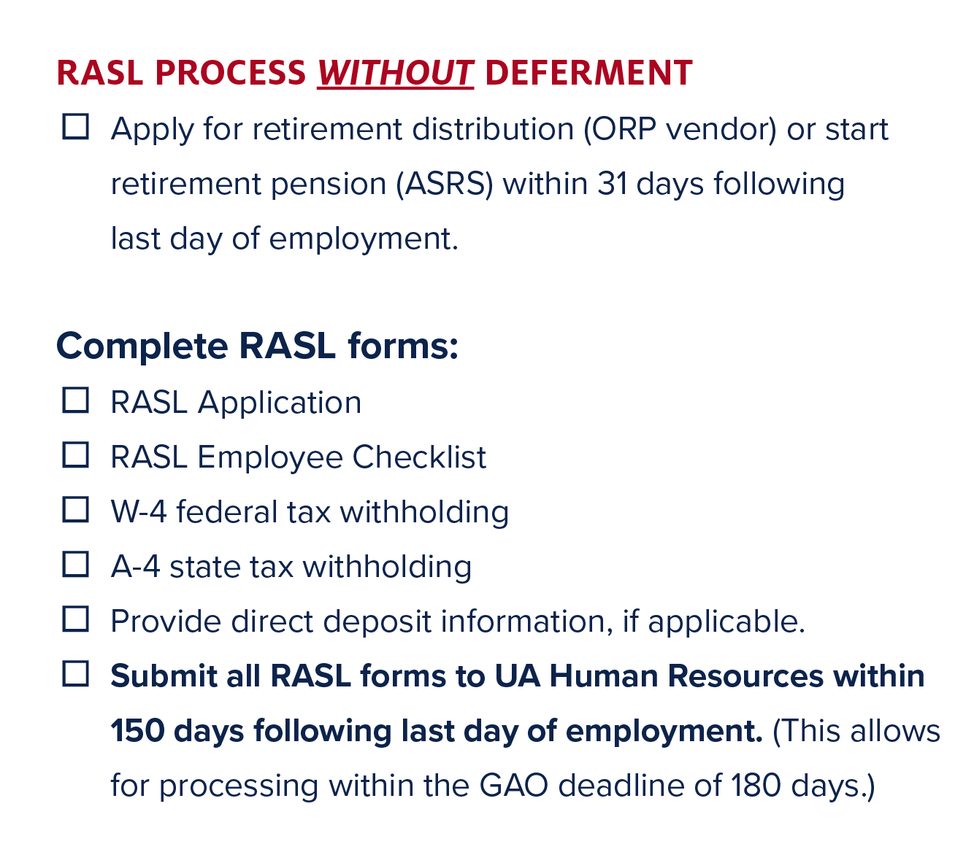
RETIREE ACCUMULATED SICK LEAVE (RASL)

Slide 20
RASL CALCULATION 500 to 749 hours = 25%
750 to 999 hours = 33%
1,000 to 1,500 hours = 50%
Example: If a retiree has a balance of 1,500 sick leave hours and separates with an hourly pay rate of $20 per hour, the total benefit would be 1,500 x 20 x 50% = $15,000.
Receive one check per year for three years.
RASL is considered income earned in Arizona, not a retirement benefit. Federal, FICA, Medicare, and Arizona state taxes are withheld from the payments.
Maximum Benefit: $30,000

Slide 21
OFFICIAL RETIREMENT STATUS
Must apply for your pension from ASRS within 30 calendar days of your separation date; and
Minimum age of 50; and
Completed five years of continuous, benefits-eligible employment in the Arizona University System (or approved leave of absence or long-term disability) immediately preceding retirement; and
Not terminated for cause by the University

Slide 22
BENEFITS OF OFFICIAL RETIREMENT
Tuition Reduction (QTR)
Free Zone 1 Parking Permit (contact Parking & Transportation)
E-mail privileges (must opt in)
UA Library loan privileges
Retain your CatCard
Discounts at UA Bookstores
Membership at Student Rec Center
BENEFITS OF OFFICIAL RETIREMENT STATUS

Slide 23
RETIREE EMAIL OPT-IN
Outlook & Office 365 deactivate 60 days after you retire
All retirees lose email access Aug. 29, 2021
OPT IN to retain your email address
Same address but reroutes to CatMail
Before retirement or during 60-day grace period
Opt-in portal already open: https://account.arizona.edu/welcome

Slide 24
Returning to work for an ASRS employer could affect or interrupt your monthly retirement benefit, so be sure to contact ASRS before you decide to return to work.
ASRS rules governing return to work are subject to Arizona revised statutes. The main factors that could affect your monthly retirement benefit are:
Whether you return to work within 12 months, and
Whether your position is benefits-eligible (more than 19 hours/week)
RETURNING TO WORK AFTER RETIREMENT

Slide 25
What’s OLLI?
Osher Lifelong Learning Institute
One of 122+ OLLI programs nationwide
Non-credit lifelong learning program for adults ages 50+
Volunteer-led membership organization
Four campus locations serving nearly 1,500 members in Southern Arizona

Slide 26
DISCOVER OLLI-UA Life Enriching Education for Adults 50+
CONTACT INFORMATION
Web: olli.arizona.edu
Email: ollimail@email.arizona.edu
Phone: 520-626-9039

Slide 27
Questions?

Slide 28
HR SOLUTIONS
520-621-3660
E-mail: hrsolutions@arizona.edu

